Slide 1
CS 504 – Programming Languages for Data Analysis Assignment 4
Lin, Junjia 002268506
Nie, Luyun 002268087

Slide 2

1. Julia (“MLBase”)

Slide 3
1.1 MLBase Introduction
Introduction: it contains several tools to support machine learning algorithms including the Cross Validation
Documentation: https://mlbasejl.readthedocs.io/en/latest/
Source: https://github.com/JuliaStats/MLBase.jl
Schemes: RandomSub, K-Fold, LOOCV

Slide 4
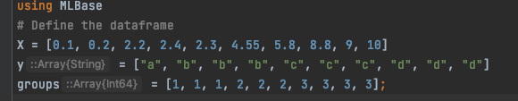
1.2 MLBase Implimentation
Data Definition

Slide 5

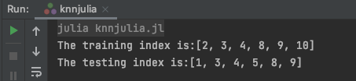
1.2.1 Non-Cross Validation
The RandomSub function randomly selects k subsets from n samples and one subset contains kn numbers of data.
The grammar is RandomSub(n, kn, k)
Non-Cross Validation – Codes
Non-Cross Validation - Results

Slide 6
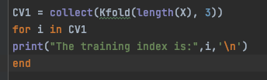

1.2.2 K-Fold Cross Validation
The Kfold function seperates n samples into k disjoint validation subsets of nearly the same length. The function returns a training subset of length about n*(1-1/k).
The grammar is Kfold(n, k)
K-Fold Cross Validation– Codes
K-Fold Cross Validation - Results

Slide 7
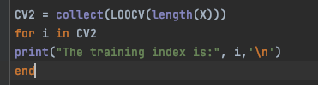
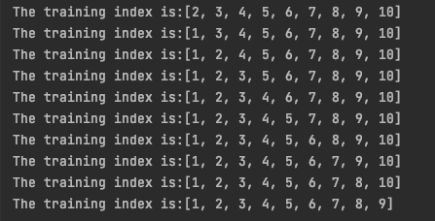
1.2.3 LOOCV
LOOCV – Codes
K-Fold Cross Validation - Results
The LOOCV function selects one of n samples as the testing subset. It returns other sample indexes as the training subset.
The grammar is LOOCV(n)

Slide 8
2. Python (“sklearn.model_selection”)

Slide 9
2.1 Scikit-learn Introduction
Introduction: Scikit-learn contains a lot of simple and usable tool for data analysis. This package was started by volunteers from 2007.
Documentation: https://scikit-learn.org/stable/
Github: https://github.com/scikit-learn/scikit-learn/tree/95119c13af77c76e150b753485c662b7c52a41a2
Schemes: ShuffleSplit, K-Fold, LeaveOneOut

Slide 10
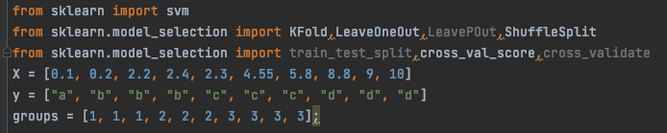
2.2 Scikit-learn. model_selection Implimentation
Data Definition

Slide 11
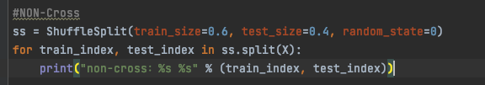
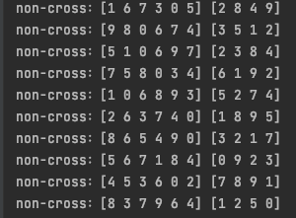
2.2.1 Non-Cross Validation
The ShuffleSplit function separates a sample into 2 subsets of sized rates. It returns both the training set and the testing set. Also, it iterates the length of sample times.
The grammar is ShuffleSplit(train_size,test_size) and X.split(Sample)
Non-Cross Validation – Codes
Non-Cross Validation - Results

Slide 12
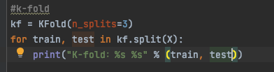

2.2.2 K-fold Validation
The KFold function separates a sample into k disjoint validation subsets of nearly the same length. The function returns both the training set and the testing set.
The grammar is KFold(k) and X.split(Sample)
K-fold Validation – Codes
K-fold Validation - Results

Slide 13
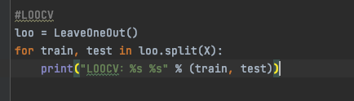
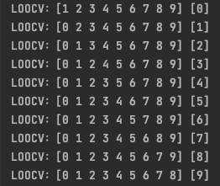
2.2.3 LOOCV Validation
LOOCV Validation – Codes
LOOCV Validation - Results
The LOOCV function selects one of n samples as the testing subset. It returns the both training set and the testing set.
The grammar is LeaveOneOut() and X.split(Sample)

Slide 14
3. R (“trainControl”)

Slide 15
3.1 TrainControl Introduction
Introduction: TrainContol provides surpots for the Train function.
Documentation: https://www.rdocumentation.org/packages/caret/versions/6.0-86/topics/trainControl
Source:
https://topepo.github.io/caret/subsampling-for-class-imbalances.html
http://www.sthda.com/english/articles/38-regression-model-validation/157-cross-validation-essentials-in-r/
Schemes: cv, LOOCV

Slide 16
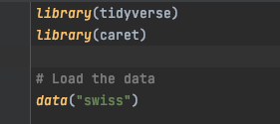
3.2 TrainControl Implimentation
Data Definition

Slide 17
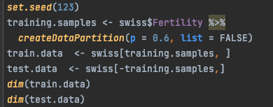
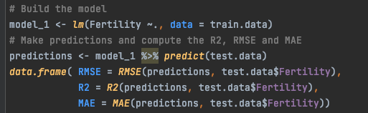


3.2.1 Non-Cross Validation
Non-Cross Validation – Codes
Non-Cross Validation - Results
The createDataPartition function separates a sample into 2 subsets of sized rates. It returns both the training set.
The grammar is createDataPartition(p)

Slide 18
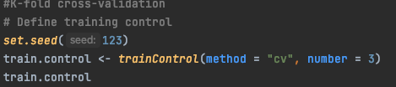
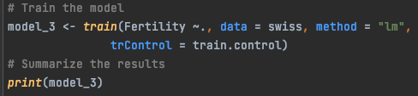
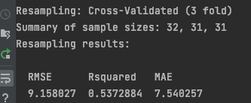
3.2.2 K-fold Validation
K-fold Validation – Codes
K-fold Validation - Results
The cv function separates a sample into k disjoint validation subsets of nearly the same length. The function returns both the training set and the testing set.
The grammar is trainControl(method, number)

Slide 19
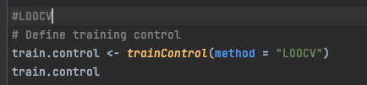
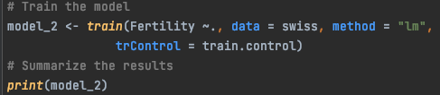
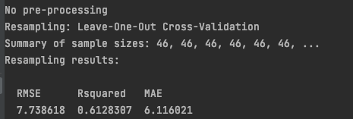
3.2.3 LOOCV Validation
LOOCV Validation – Codes
LOOCV Validation - Results
The LOOCV function selects one of n samples as the testing subset. It returns the testing size.
The grammar istrainControl(method = ‘LOOCV’)

Slide 20
4. Octave (“cvpartition”)

Slide 21
4.1 Cvpartion Introduction
Introduction: Cvpartion provides seperation samples.
Documentation: https://octave.sourceforge.io/statistics/function/@cvpartition/cvpartition.html
Source: https://www.mathworks.com/help/stats/cvpartition.html
Schemes: Houdout,KFold, Leaveout

Slide 22
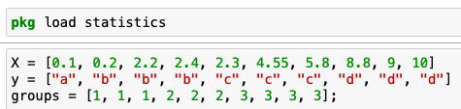
4.2 Cvpartion Implimentation
Data Definition

Slide 23
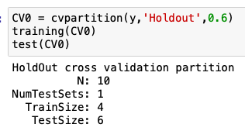


4.2.1 Non-Cross Validation
Non-Cross Validation – Codes
Non-Cross Validation - Results
The cvpartition function separates a sample into 2 subsets of sized rates. It returns both the training set and the test set.
The grammar is cvpartition(X,’Holdout’,p)

Slide 24
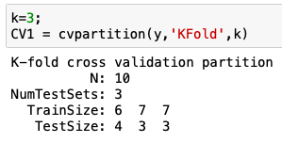
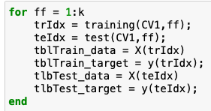
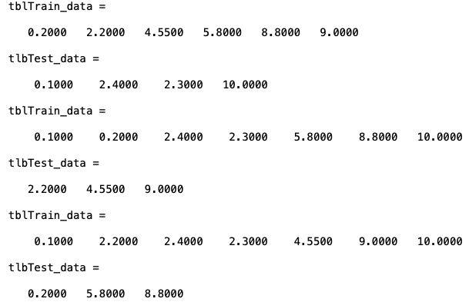
4.2.2 K-fold Validation
K-fold Validation – Codes
K-fold Validation - Results
The KFold function separates a sample into k disjoint validation subsets of nearly the same length. The function returns both the training set and the testing set.
The grammar is cvpartition(y,’KFold’,k)

Slide 25
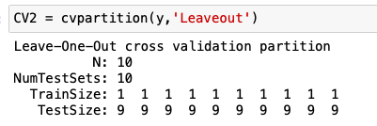
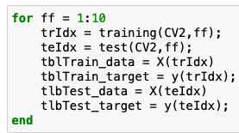
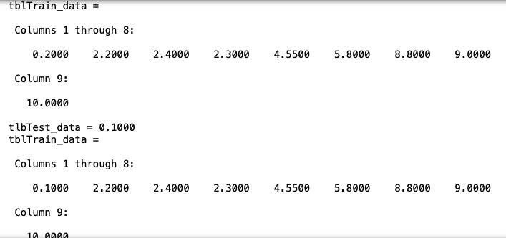
4.2.3 LOOCV Validation
LOOCV Validation – Codes
LOOCV Validation - Results
The LOOCV function selects one of n samples as the testing subset. It returns the testing and the training set.
The grammar cvpartition(y, ‘Leaveout’)

Slide 26
conclusion
Which one of the programming languages that you studied does support best the three variants of cross-validation? Justify your answer.
Answer: We considered that the R supporting best of cross-validation. Cross Validation is a process of machine learning in testing. In R, its machine learning algorithms contain control functions where cross validation can be applied within the ‘TrainControl’ module. As we mentioned before, no extra split functions needed to perform cross validation. By other languages, at least one line code should be written to separate rows.

Slide 27
conclusion
2. Do all the programming languages that you studied support the three variants of cross- validation?
Answer: All languages we studied support the three variants of cross validation. Considered the executing time, the grammar and the documentation, R won the champion of other three. It executes fast and has specified application documentation. Beginners like us could learn it quicker.

Slide 28
References
Julia
https://scikitlearnjl.readthedocs.io/en/latest/quickstart/
https://scikitlearnjl.readthedocs.io/en/latest/cross_validation/
Python
https://scikit-learn.org/stable/modules/cross_validation.html
R
http://www.sthda.com/english/articles/38-regression-model-validation/157-cross-validation-essentials-in-r/
Octave
https://www.mathworks.com/help/stats/cvpartition.html

